Slide 1
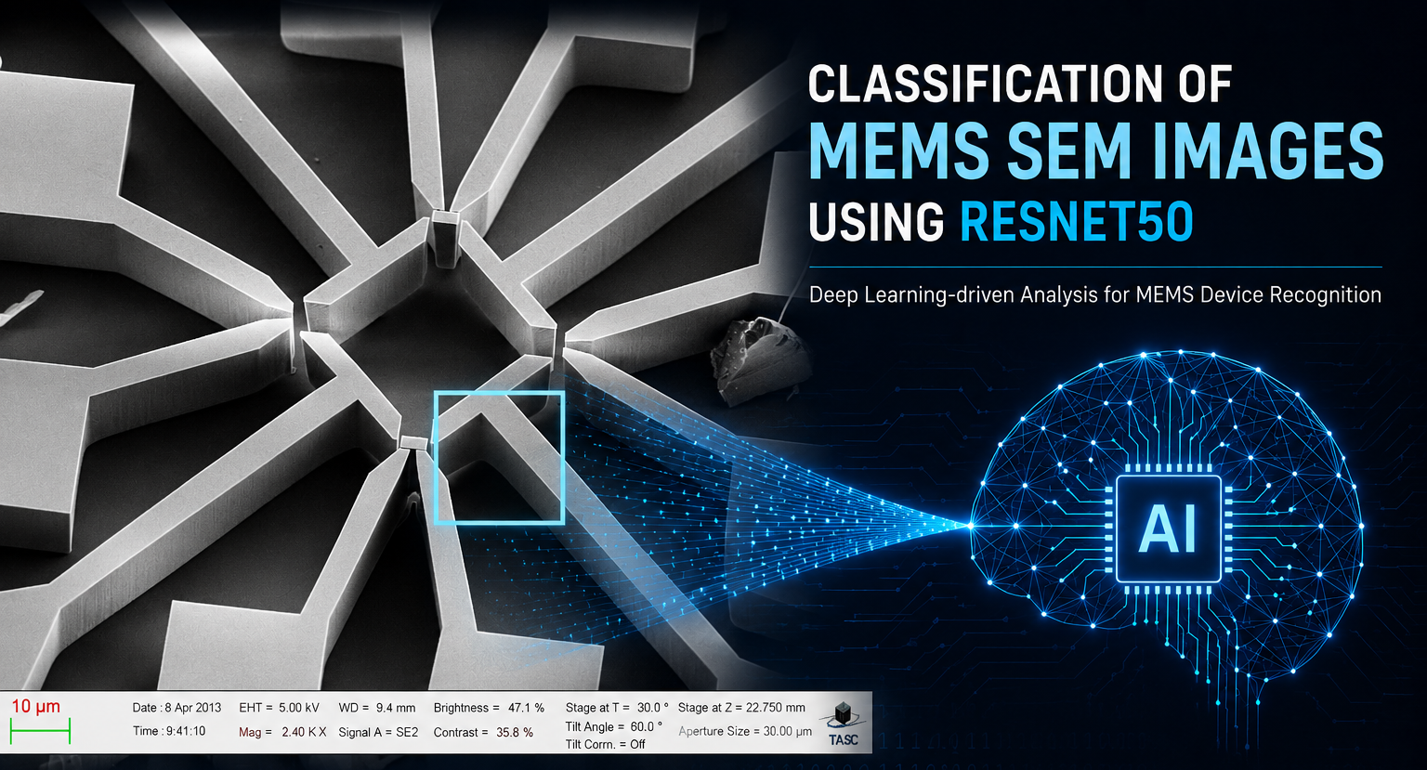
Presenter: Negar Ziehm
25 June 2026
10µM
ETH= 5.00 kV Mag= 2.40 KX WD= 9.4 mm Signal A= SE2

Slide 2
Table of content
01 | Introduction
02 | Litreture Review
03 | Dataset Characteristics
04 | Model
05 | Model development and evaluation
06 | Results, Challenges and Errors
07 | Discussion
08 | Q&A
Classification of MEMS SEM Images using ResNet 50 - Negar Ziehm
1

Slide 3
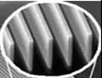
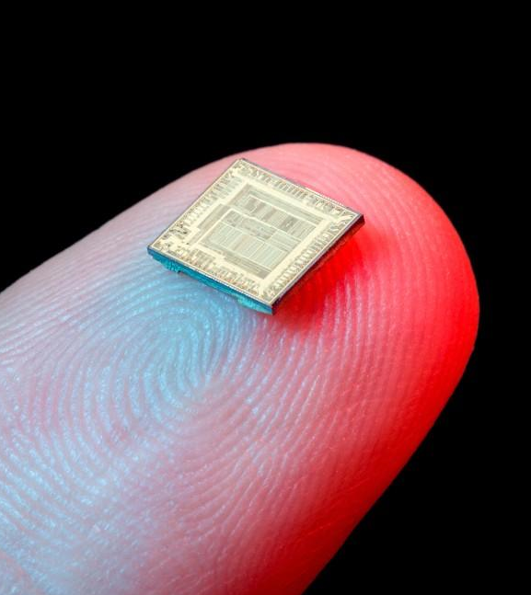
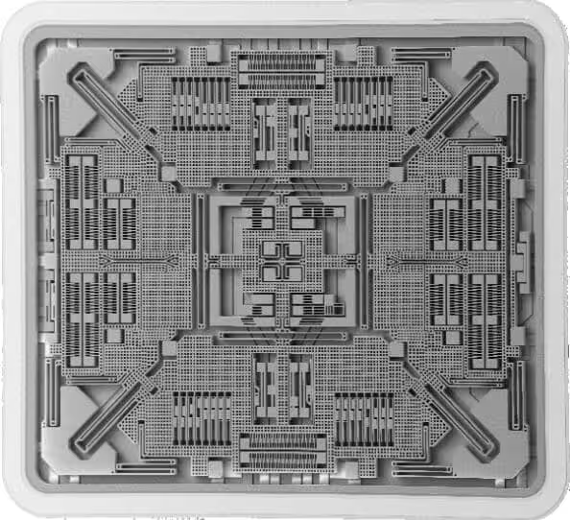

Introduction
MEMS
Micro-Electro-Mechanical Systems
miniaturized devices integrated mechanical structures, sensors, actuators, and electronics
Built on a single chip.
widely used in Sensors, biomedical devices communication systems and industrial applications
SEM
Scanning Electron Microscopy
uses a focused beam of electrons to scan a sample surface
Provides high-resolution images of micro/nano structures.
Essential for inspection and evaluating MEMS structures.
Classification of MEMS SEM Images using ResNet 50 - Negar Ziehm
2

Slide 4
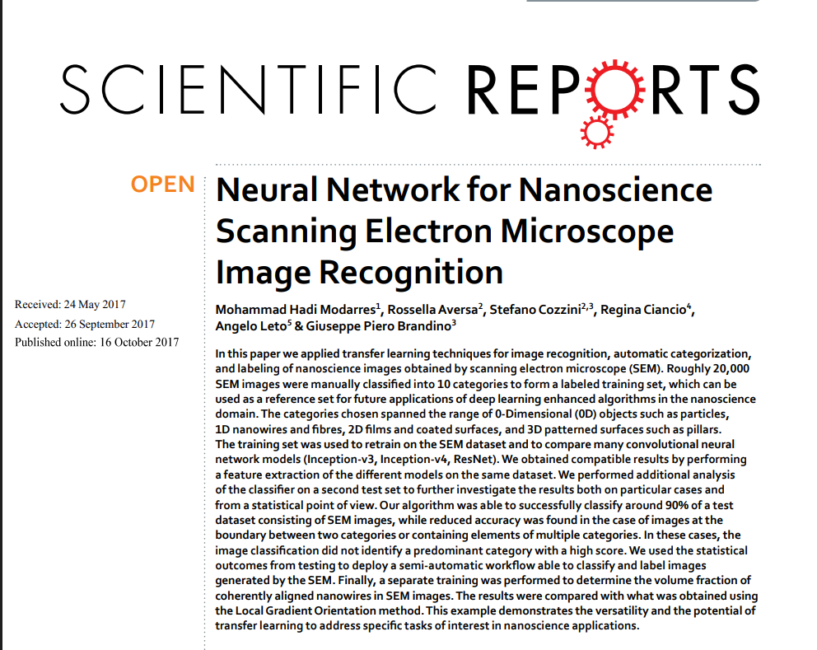
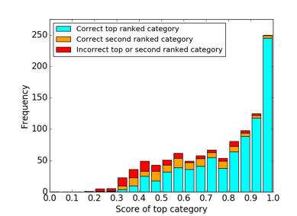
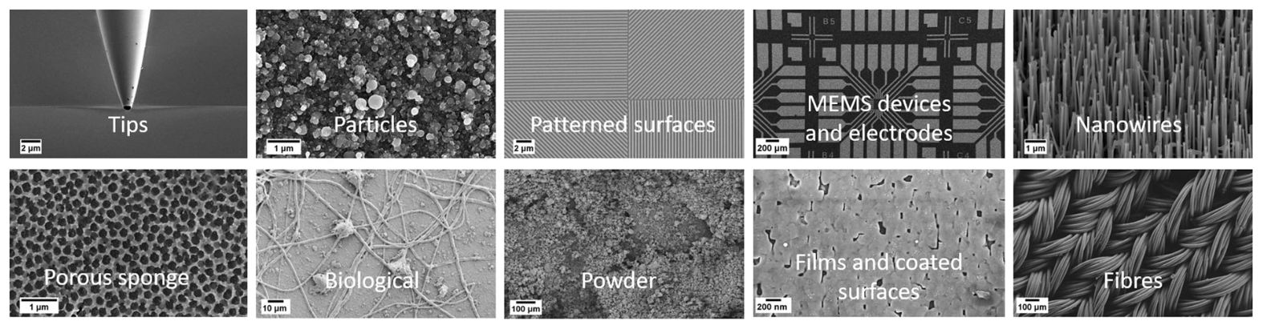
Literature Review
Methodology
Manually annotated 18,577 SEM images into 10 categories.
Used transfer learning / feature extraction with CNNs pretrained on ImageNet. Main model: Inception-v3.
For Inception-v3, they retrained mainly the last layers: softmax + fully connected layer.
Dataset split: 80% training, 10% validation, 10% test.
They also compared Inception-v3, Inception-slim, Inception-v4, and Inception-ResNet-v2;
Key Results
Achieved ~90% classification accuracy
More confusion appeared for visually similar classes such as Patterned_surface and MEMS_devices_and_electrodes
Demonstrated that pretrained CNNs can successfully recognize complex SEM morphologies.
In the model comparison, Inception-v4 and Inception-ResNet-v2/“ResNet” gave comparable results, but the “ResNet” result was slightly worse and less stable at 5000 steps.
Classification of MEMS SEM Images using ResNet 50 - Negar Ziehm
3

Slide 5
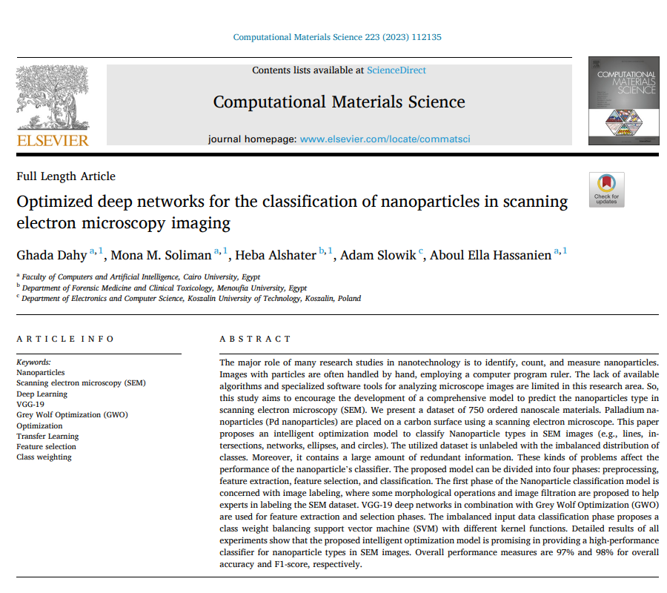
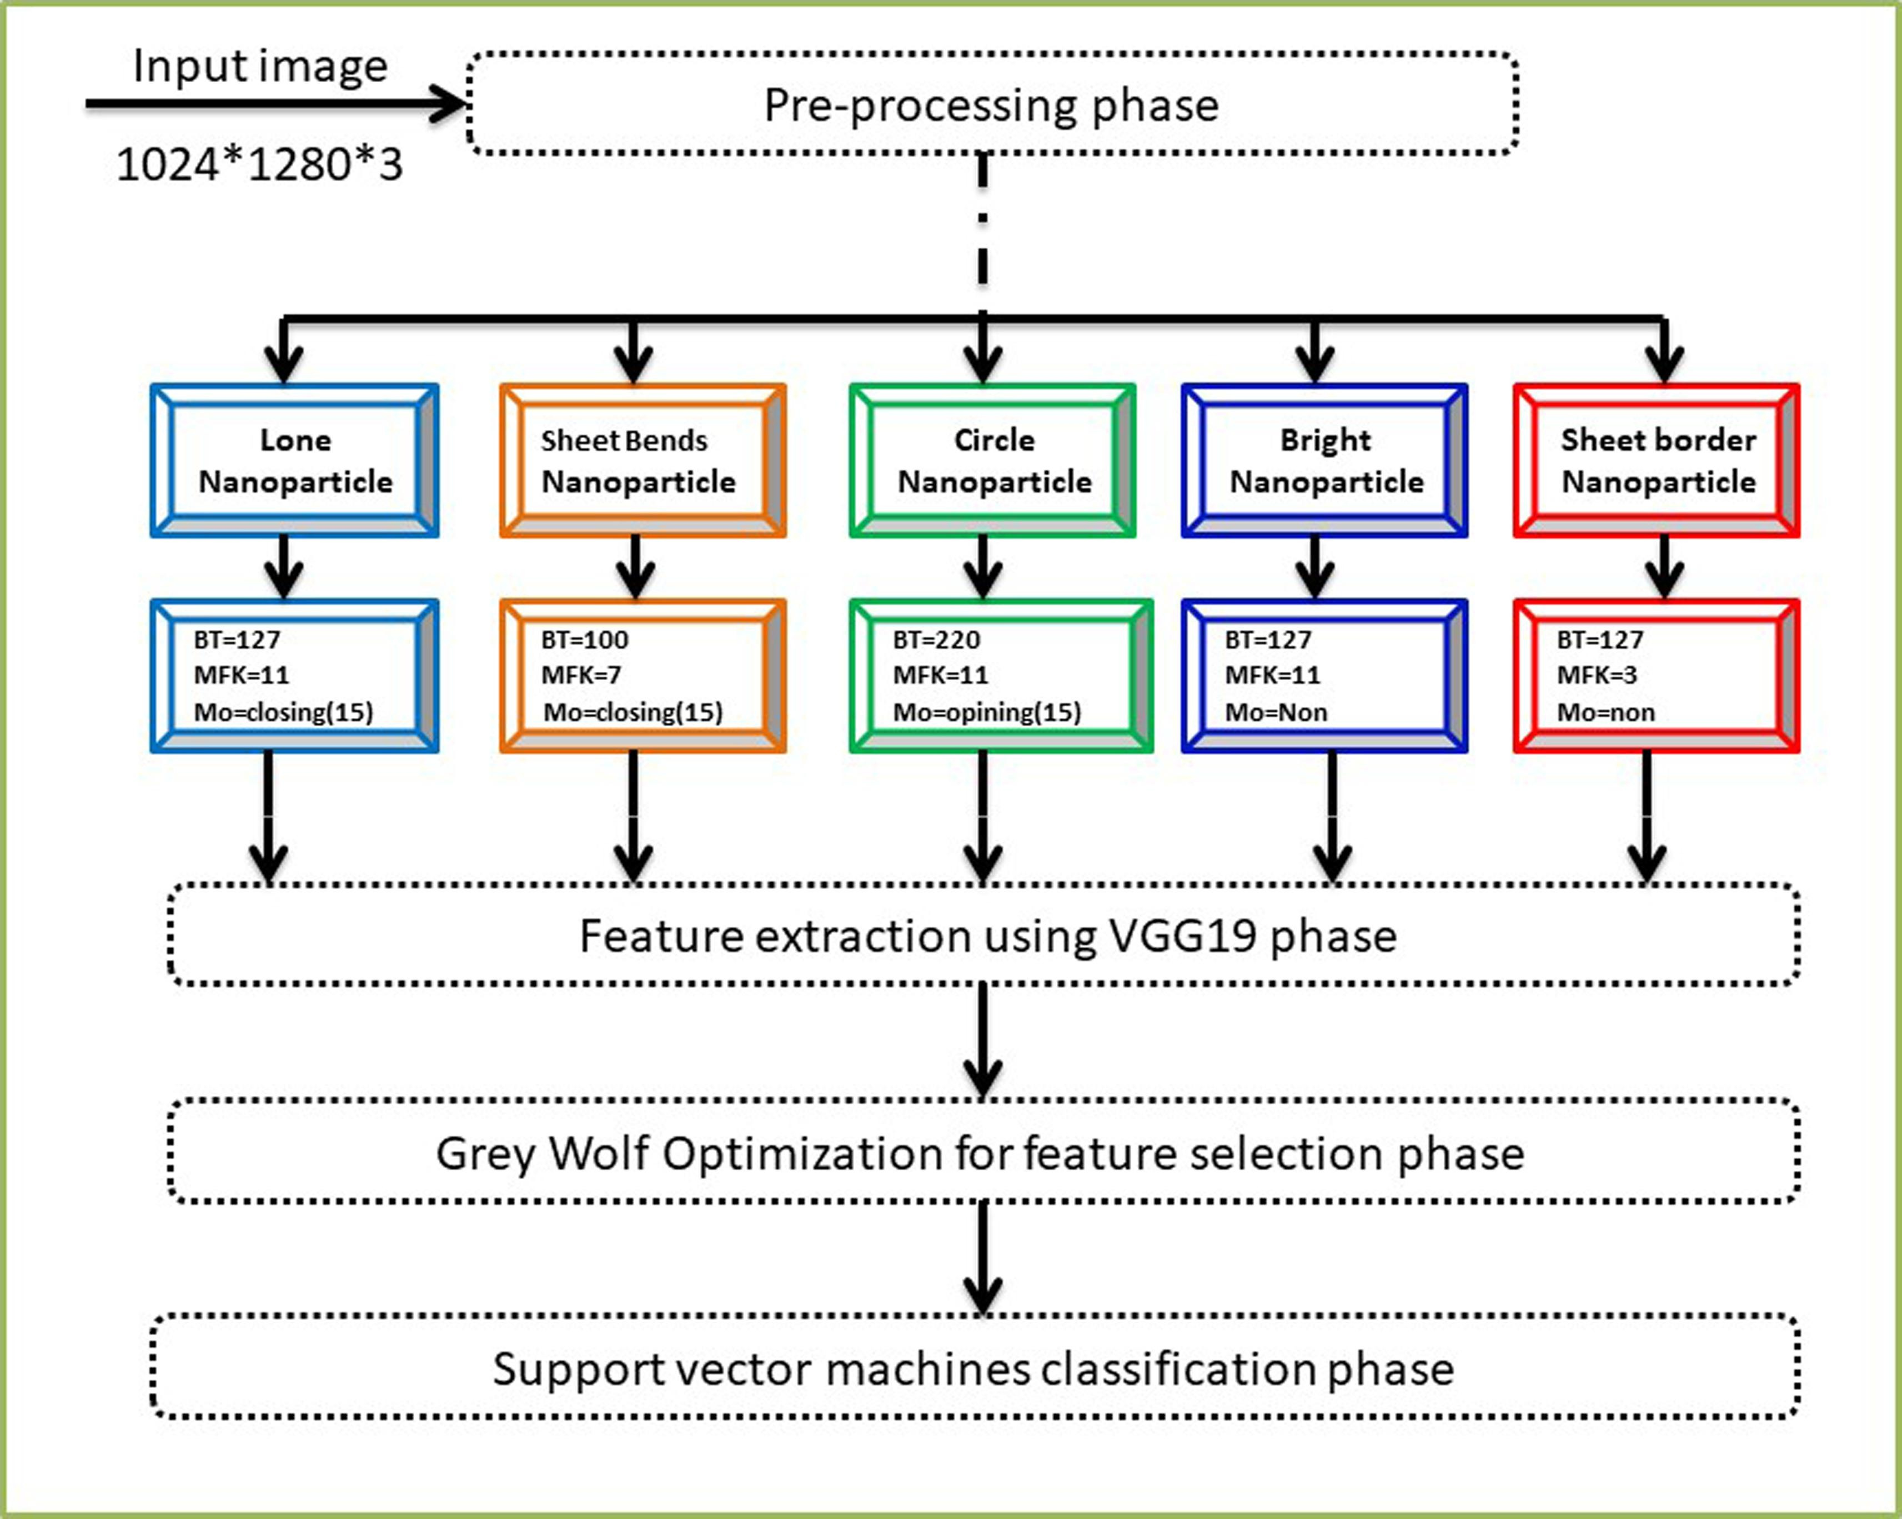
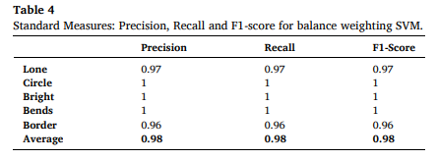
Literature Review
Methodology
SEM images of Pd nanoparticles
Manual labeling into 5 morphology classes
Image preprocessing and filtering
Transfer learning with VGG-19
Grey Wolf Optimization for feature selection
Weighted SVM for final classification
Key Results
97% classification accuracy
98% F1-score
Improved performance on imbalanced dataset
Reduced redundant image features
Effective automated nanoparticle classification
Classification of MEMS SEM Images using ResNet 50 - Negar Ziehm
3

Slide 6
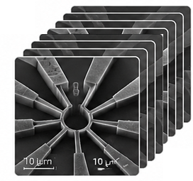

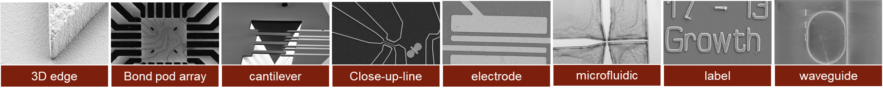
Objective
The objective of this project is to develop an automated image classification system capable of recognizing different MEMS structures from SEM images using deep learning techniques.
Prediction
Electrode | 92%
Cantilever | 4.3%
waveguide | 0.7%
…
SEM Images of MEMS devices and components
Deep Learning Model for Classification
Target Classes (8)
Classification of MEMS SEM Images using ResNet 50 - Negar Ziehm
4

Slide 7
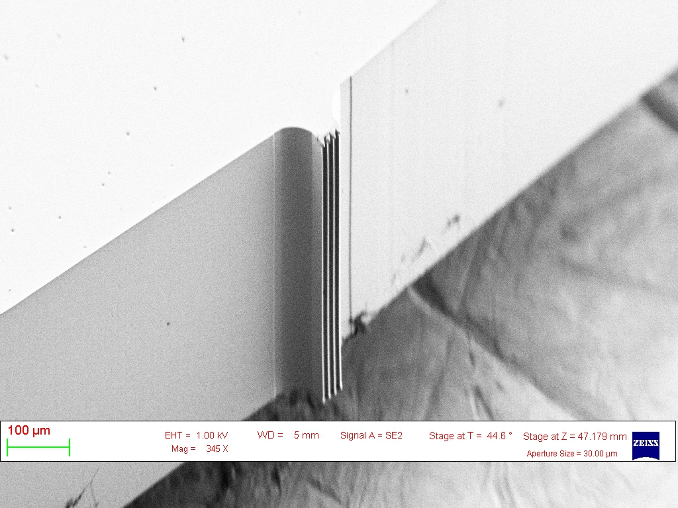
Dataset Characterization
Image preprocessing
03
Metadata removal and grayscale training
80/20 train-validation split (additional unlabeled images were used only for inference inspection)
Manual Annotation
02
2,800 images categorized into 8 classes
Data Collection
01
4,158 SEM images from Kaggle
(NFFA-EUROPE - SEM Dataset)
Classification of MEMS SEM Images using ResNet 50 - Negar Ziehm
5

Slide 8
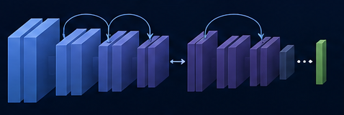

Model
ResNet-50
Pretrained Weights/ Cropped SEM Images
8 classes with Accuracy of 92.97%
Final classification layer has been replaced and fine-tuned the model on MEMS dataset for 8 classes.
learning rate: 0.00003
Number of epochs: 20
batch size: 16
freeze-backbone-epochs: 3
Why Pre-trained ResNet-50 as baseline?
Pretrained Features
ResNet-50
Improved Performance
Reliable Baseline
Leverages knowledge from millions of images to learn general features (edges, textures, shapes).
well-established and widely validated deep learning architecture for image classification.
Better accuracy with limited data due to powerful feature representation.
uses residual connections, which allow the network to be much deeper while avoiding the vanishing gradient problem.
Classification of MEMS SEM Images using ResNet 50 - Negar Ziehm
6

Slide 9
Model
ResNet-50
Pretrained Weights/ Cropped SEM Images
8 classes with Accuracy of 92.97%
Final classification layer has been replaced and fine-tuned the model on MEMS dataset for 8 classes.
learning rate: 0.00003
Number of epochs: 20
batch size: 16
freeze-backbone-epochs: 3
Target Classes (8)
precision: 0.97
recall: 0.99
f1-score: 0.97
support: 94.0
precision: 0.97
recall: 1.0
f1-score: 0.99
support: 165
precision: 0.87
recall: 1.0
f1-score: 0.93
support: 7.0
precision: 0.92
recall: 0.84
f1-score: 0.88
support: 132.0
precision: 0.86
recall: 0.90
f1-score: 0.88
support: 126.0
precision: 1.0
recall: 0.25
f1-score: 0.4
support: 4.0
precision: 0.0
recall: 0.0
f1-score: 0.0
support: 1.0
precision: 0.90
recall: 1.0
f1-score: 0.94
support: 26.0
Classification of MEMS SEM Images using ResNet 50 - Negar Ziehm
6

Slide 10
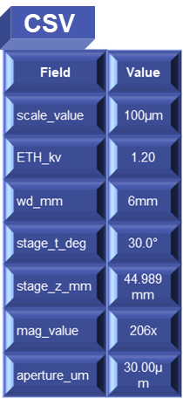
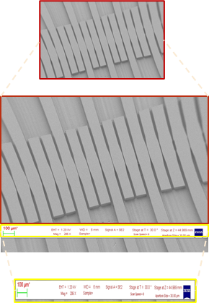
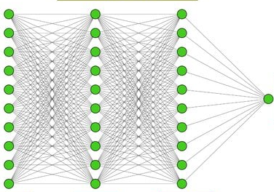
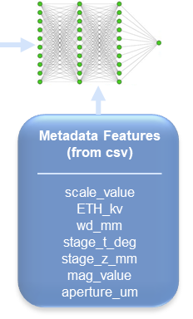

Model Development and Evaluation
1. Cropped Image
2. OCR Extraction
3. Feed the Metadata Features to Model
4. Hyperparameter Changes
Training
Grey Image Input
Grey Image Input
Output
Output
Experiment 1
Epoch : 20
Learning Rate: 3e-5
Freeze-backbone epoch: 0
Metadata
Experiment 2
Gray area (sample region) is cropped and used to train the baseline model.
OCS is applied to extract test from the white ribbon and save it as structured data in a CSV file.
Structured Metadata is used as additional features (metadata input) and combined with image features in the baseline model.
Epoch : 30
Learning Rate: 1e-5
Freeze-backbone epoch: 3
Classification of MEMS SEM Images using ResNet 50 - Negar Ziehm
7

Slide 11
Model Development and Evaluation
1. Cropped Image
2 OCR Extraction
3. Feed the Metadata Features to Model
4. Hyperparameter Changes
Training
Grey Image Input
Grey Image Input
Output
Output
Experiment 1
Epoch : 20
Learning Rate: 3e-5
Freeze-backbone epoch: 0
Metadata
Experiment 2
Gray area (sample region) is cropped and used to train the baseline model.
OCS is applied to extract test from the white ribbon and save it as structured data in a CSV file.
Structured Metadata is used as additional features (metadata input) and combined with image features in the baseline model.
Epoch : 30
Learning Rate: 1e-5
Freeze-backbone epoch: 3
Classification of MEMS SEM Images using ResNet 50 - Negar Ziehm
7

Slide 12
Model Development and Evaluation
1. Cropped Image
2 OCR Extraction
3. Feed the Metadata Features to Model
4. Hyperparameter Changes
Training
Grey Image Input
Grey Image Input
Output
Output
Experiment 1
Epoch : 20
Learning Rate: 3e-5
Freeze-backbone epoch: 0
Metadata
Experiment 2
Gray area (sample region) is cropped and used to train the baseline model.
OCS is applied to extract test from the white ribbon and save it as structured data in a CSV file.
Structured Metadata is used as additional features (metadata input) and combined with image features in the baseline model.
Epoch : 30
Learning Rate: 1e-5
Freeze-backbone epoch: 3
Classification of MEMS SEM Images using ResNet 50 - Negar Ziehm
7

Slide 13
Model Development and Evaluation
1. Cropped Image
2 OCR Extraction
3. Feed the Metadata Features to Model
4. Hyperparameter Changes
Training
Grey Image Input
Grey Image Input
Output
Output
Experiment 1
Epoch : 20
Learning Rate: 3e-5
Freeze-backbone epoch: 0
Metadata
Experiment 2
Gray area (sample region) is cropped and used to train the baseline model.
OCS is applied to extract test from the white ribbon and save it as structured data in a CSV file.
Structured Metadata is used as additional features (metadata input) and combined with image features in the baseline model.
Epoch : 30
Learning Rate: 1e-5
Freeze-backbone epoch: 3
Classification of MEMS SEM Images using ResNet 50 - Negar Ziehm
7

Slide 14
Model Development and Evaluation
1. Cropped Image
2 OCR Extraction
3. Feed the Metadata Features to Model
4. Hyperparameter Changes
Training
Grey Image Input
Grey Image Input
Output
Output
Experiment 1
Epoch : 20
Learning Rate: 3e-5
Freeze-backbone epoch: 0
Metadata
Experiment 2
Gray area (sample region) is cropped and used to train the baseline model.
OCS is applied to extract test from the white ribbon and save it as structured data in a CSV file.
Structured Metadata is used as additional features (metadata input) and combined with image features in the baseline model.
Epoch : 30
Learning Rate: 1e-5
Freeze-backbone epoch: 3
Classification of MEMS SEM Images using ResNet 50 - Negar Ziehm
7

Slide 15
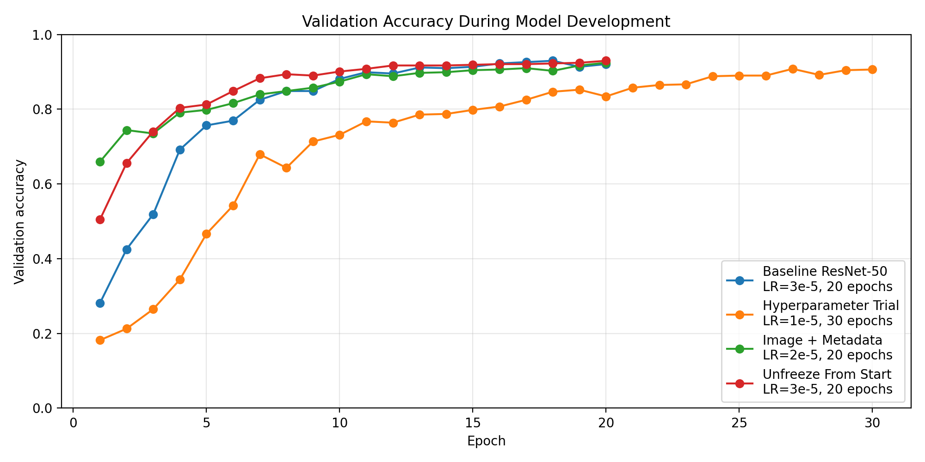
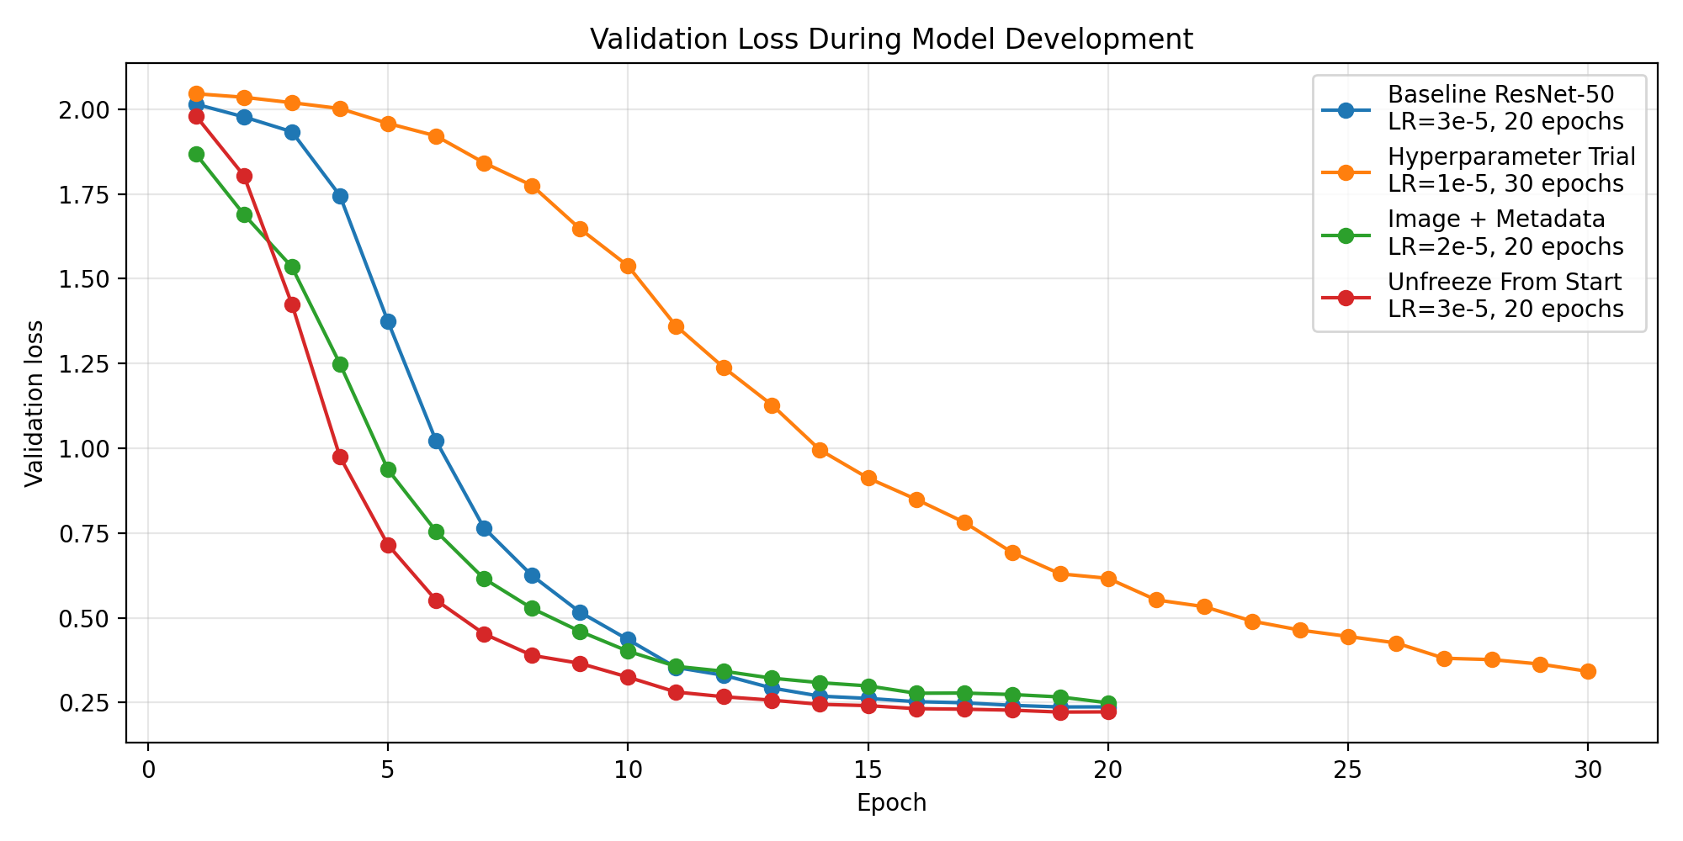
Results and Discussion
Freeze backbone epoch
Metadata
Epoch
Learning rate
Increasing epochs alone is unlikely to improve performance.
The pretrained ResNet-50 features were already suitable for SEM gray Image, so unfreezing the backbone from the start did not clearly improve performance.
improved early training performance and reached higher validation accuracy in the first few epochs.
lower learning rate did not improve the model.
Classification of MEMS SEM Images using ResNet 50 - Negar Ziehm
8

Slide 16
Challenges and Errors
01
Manual image classification
manually sorting data into 8 categories was time-consuming and introduced the risk of human labeling mistakes, especially for visually similar classes such as close_up_line and Electrode.
Separating SEM image from microscope information
02
Each image contained a gray SEM region and a white microscope information ribbon. Using the full image could make the model learn from text or scale information instead of the actual structure.
Class imbalance
03
Some classes had many images, while others had very few, such as microfluidic, cantilever, and label. This could bias the model toward majority classes.
Modeling challenge
04
ML for business
More complex models did not automatically perform better. Adding OCR metadata and changing hyperparameters reduced or did not improve accuracy.
Classification of MEMS SEM Images using ResNet 50 - Negar Ziehm
9

Slide 17

Thanks for your attention!
MEMS
Questions are welcome,
Easy ones are appreciated ☺

